Slide 1





IoT Based Flame & Gas Detection System
Presenters: MN. Sihanas & AJ. Nishak Mohamed
CSD 22
Assessor: Eng. Sajith
IoT

Slide 2
Table Of Contents
Introduction
Problem Statement
Objectives
Proposed Solution
System Architecture
System Tools and Framework
Circuit Diagram
Outcome
Methodology
Benefits of the Solution
Cost
Conclusion
IoT

Slide 3
Introduction
IoT

Slide 4
This project focuses on safety by developing an IoT-based gas and flame detection system. It uses sensors with real-time alerts via buzzer, LEDs, and the Blynk app to ensure early hazard detection and quick response.
IoT

Slide 5
Problem Statement
IoT

Slide 6
Undetected Hazards: Gas leaks and fire outbreaks often go unnoticed in their early stages, increasing risk to life and property.
Delayed Response: Lack of real-time alerts leads to slower emergency actions.
Limited Traditional Systems: Conventional alarms are not connected to IoT, restricting remote monitoring.
Safety Concerns: Absence of efficient detection systems compromises overall safety in homes and workplaces.
IoT
Notes:
The main problems this project addresses are undetected gas leaks and fire hazards that can cause serious damage. Traditional systems often provide only local alarms and lack real-time alerts, which delays response. Without IoT integration, remote monitoring is limited, making safety measures less effective in critical situations.

Slide 7
Objectives
IoT

Slide 8
Detect Hazards Automatically: Use MQ2 and flame sensors to identify gas leaks and fire in real time.
Provide Local Alerts: Trigger buzzer and LEDs instantly to warn nearby users.
Enable Remote Monitoring: Send notifications to the Blynk app for quick action even when away.
Enhance Safety: Reduce risks by ensuring timely detection and response.
IoT
Notes:
The objectives are to detect gas leaks and fire hazards automatically, provide local alerts through a buzzer and LEDs, and enable remote monitoring using the Blynk app. Altogether, the system is designed to improve safety by allowing quick detection and response.

Slide 9
Proposed Solution
IoT

Slide 10
Proposed Solution Overview:
IoT-enabled system for detecting gas leaks and flames using ESP32, MQ2, and IR flame sensor with real-time alerts.
Key Features:
Local alerts via buzzer and LEDs.
Remote notifications through the Blynk app.
Continuous monitoring for early hazard detection.
Advantages:
Ensures timely response to emergencies.
Improves safety in homes and workplaces.
Scalable and cost-effective IoT-based safety solution.
IoT
Notes:
The proposed solution is an IoT-based gas and flame detection system that combines ESP32, MQ2, and flame sensors. It gives local alerts through a buzzer and LEDs, while also sending real-time notifications to the Blynk app. This setup ensures early detection, improves safety, and provides a scalable and cost-effective approach to hazard prevention.

Slide 11
System Architecture
IoT

Slide 12
IoT Architecture Layers:
  Perception Layer: MQ2 gas sensor and flame sensor detect hazards; buzzer and LEDs act as actuators for local alerts.
  Transport Layer: Wi-Fi on ESP32 enables communication between the system and the Blynk cloud.
  Processing Layer: ESP32 processes sensor data and triggers alerts locally and remotely.
  Application Layer: Blynk app provides real-time notifications and monitoring for users.
  Business Layer: Focuses on enhancing safety, reducing risks, and offering a scalable IoT-based hazard detection solution.
IoT
Notes:
The system follows a typical IoT architecture. In the perception layer, MQ2 and flame sensors collect data while the buzzer and LEDs provide local alerts. The transport layer uses Wi-Fi on ESP32 to send data to the cloud. In the processing layer, ESP32 interprets the sensor inputs and triggers alerts. The application layer is the Blynk app, which gives real-time notifications to users. Finally, the business layer ensures that the system improves safety and offers a scalable solution for hazard detection.

Slide 13
System Tools and Frameworks
IoT

Slide 14


Tools, Software & Frameworks:
Arduino IDE: Used for coding and uploading programs to ESP32.
Blynk App: Provides real-time alerts and remote monitoring.
Blynk Library: Enables communication between ESP32 and the Blynk cloud.
ESP32 Library: Provides support for ESP32 board in Arduino IDE.
IoT
Notes:
For the software side, we used Arduino IDE to implement and upload the code to the ESP32. The Blynk app was used for remote monitoring and alerts. We also integrated the Blynk library and ESP32 library, which made communication and hardware support possible.

Slide 15
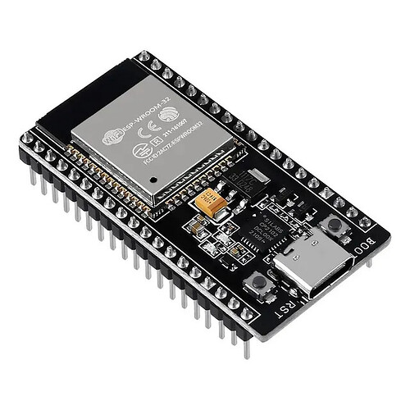
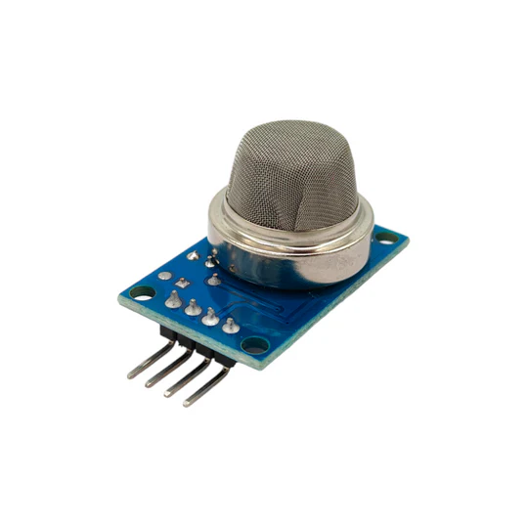
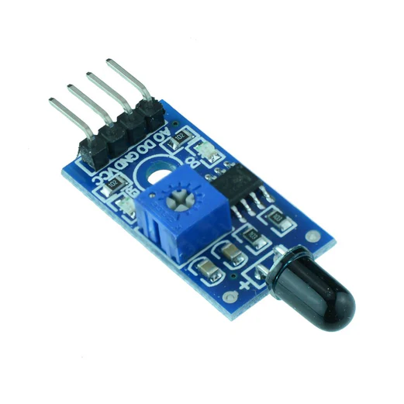

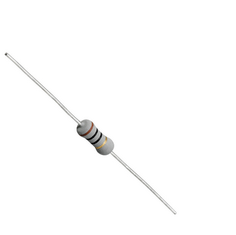
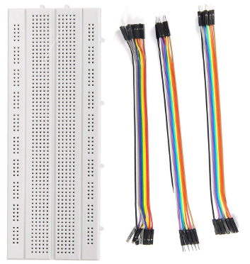
Hardware Components:
ESP32 (NodeMCU Devkit V1): Main microcontroller board with Wi-Fi capability.
MQ2 Gas Sensor: Detects the presence of harmful gases.
IR Flame Sensor: Detects fire or flame sources.
LEDs & Resistors: Indicate gas or flame detection with visual alerts.
Buzzer: Provides audible alarm during hazard detection.
Breadboard & Jumper Wires: For circuit prototyping and connections.
IoT
Notes:
For the hardware, we used ESP32 as the core controller, with MQ2 and flame sensors for detection. LEDs with resistors were added for visual alerts, and a buzzer for sound alarms. A breadboard and jumper wires helped us assemble the circuit neatly.

Slide 16
Circuit Diagram
IoT

Slide 17
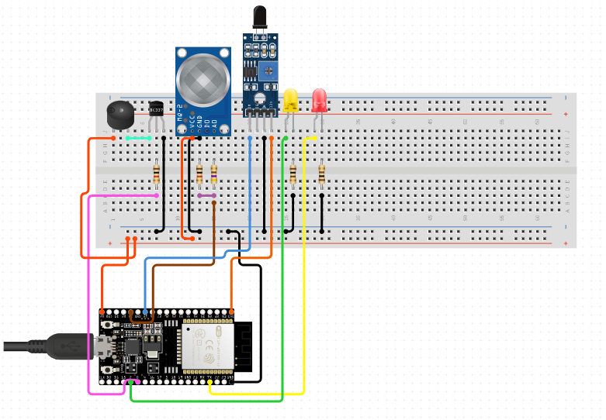
IoT
17

Slide 18
Final Outcome
IoT

Slide 19
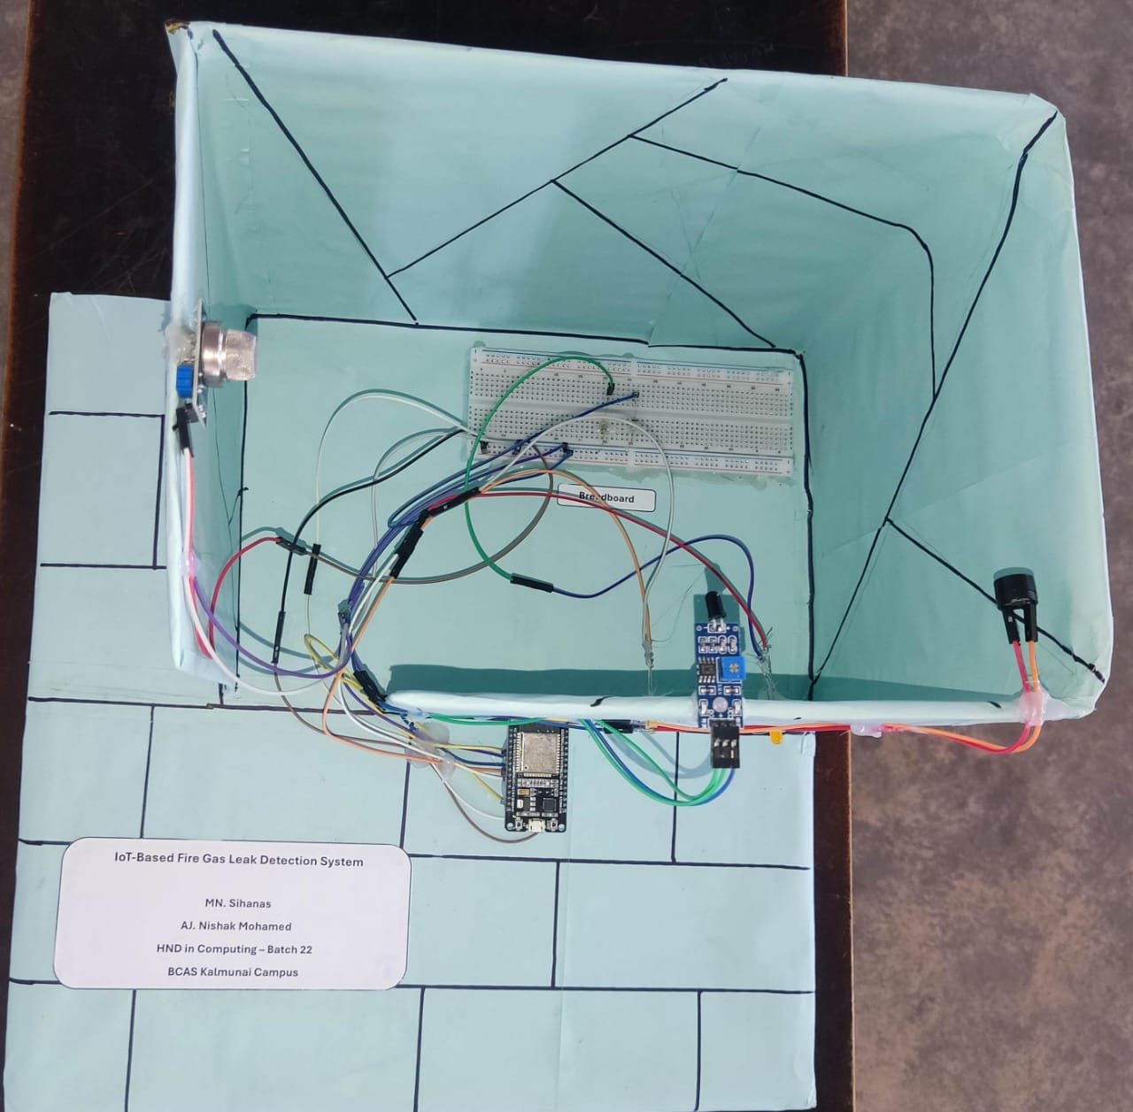
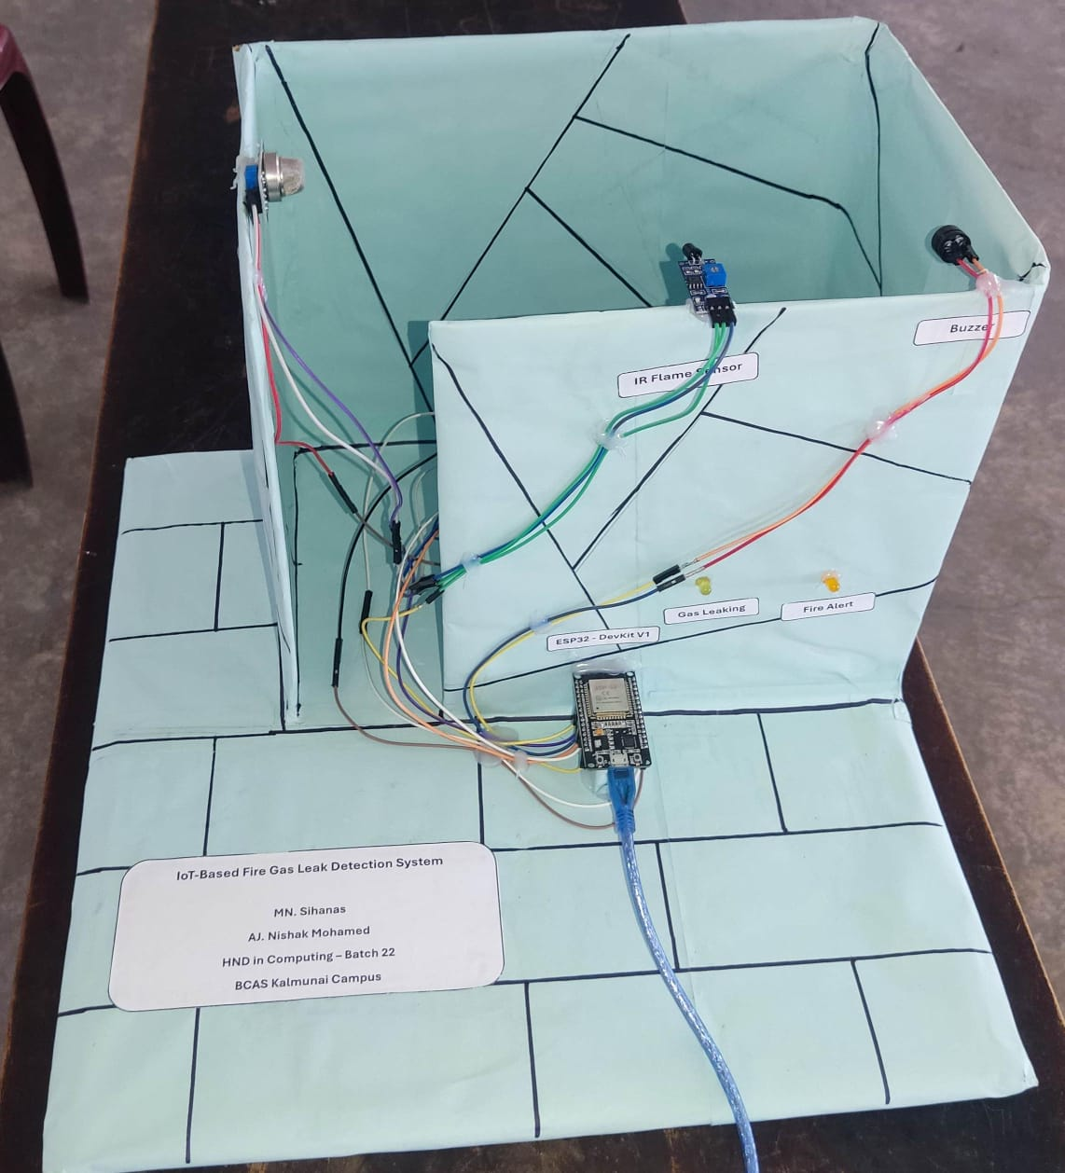
IoT
19

Slide 20
Demonstration
IoT
Notes:
Let me explain how the system works in real use. Once the ESP32 is powered on, the sensors start monitoring the environment. If the gas sensor detects harmful gases, the gas LED will light up, the buzzer will sound, and an alert is sent to the Blynk app. Similarly, if the flame sensor detects fire, the flame LED turns on, the buzzer sounds, and the app notifies the user. If nothing is detected, the system stays in standby mode. This ensures real-time detection and quick alerts for safety.

Slide 21
Methodology
IoT
Final Presentation

Slide 22
Hardware Setup:
  Assemble components: NodeMCU ESP32, MQ2 Gas Sensor, IR Flame Sensor, LEDs, Buzzer, Resistors.
  Connect components according to the designed circuit diagram.
Software Development:
  Write and upload code using Arduino IDE.
  Configure Blynk app for real-time monitoring and alerts.
Testing:
  Test individual sensors to ensure correct detection of gas leaks and flames.
  Verify LED and buzzer alerts, and remote notifications via the Blynk app.
  Adjust sensor sensitivity and detection thresholds as needed.
User Feedback and Iteration:
  Collect observations during testing to identify false triggers or delays.
  Refine code, improve alert timing, and optimize overall system reliability.
IoT
Notes:
We first assembled the ESP32, sensors, LEDs, and buzzer as per the circuit diagram. Then, we wrote the code in Arduino IDE and configured the Blynk app for real-time alerts. We tested the sensors and alarms, adjusted sensitivity, and refined the system to ensure reliable detection of gas leaks and flames.

Slide 23
Benefits of the Solution
IoT

Slide 24
Safety Enhancement: Provides real-time alerts for gas leaks and flames, preventing accidents.
User Convenience: Remote monitoring and notifications through the Blynk app.
Early Detection: Detects hazards promptly to reduce damage and risk.
Cost Savings: Minimizes potential losses from fire or gas-related incidents.
Scalability: Can integrate with additional IoT sensors or smart home systems.
IoT
Notes:
Our system improves safety by providing instant alerts for gas leaks and flames. Users can monitor conditions remotely via the Blynk app. Early detection helps reduce damage, while preventing accidents saves costs. The system is also scalable for future IoT integrations

Slide 25
Cost
IoT

Slide 26
Component/Category | Units/Description | Approximate Cost (LKR)
Node MCU ESP32 DevKit | 1 unit | 1950.00
Breadboard | 1 unit | 365.00
MQ-2 Gas sensor | 1 unit | 550.00
IR flame sensor | 1 unit | 300.00
Jumper Wires, buzzer, LEDs, and Resistors | Essentials | 800.00
 | Total : | 3965.00
IoT

Slide 27
Conclusion
IoT

Slide 28
Summary:
  The IoT-based Flame & Gas Detection System provides real-time monitoring to enhance safety, prevent hazards, and reduce potential damage from gas leaks or fire.
  It is reliable, user-friendly, and scalable for future improvements.
Impact:
  For individuals: Increased safety and peace of mind.
  For homes or businesses: Reduced risk of accidents, minimized losses, and timely alerts.
Future Scope:
  Integration with additional IoT sensors and smart home systems.
  Enhanced features like automated emergency responses and cloud-based analytics.
IoT
Notes:
In summary, our system ensures real-time safety monitoring, making homes and workplaces safer from fire and gas hazards. It provides peace of mind for users and reduces potential losses. In the future, it can be integrated with more IoT devices and include features like automated emergency responses and cloud analytics.

Slide 29
Any Question ?
IoT

Slide 30
<- Thank You ->
IoT

